Slide 1
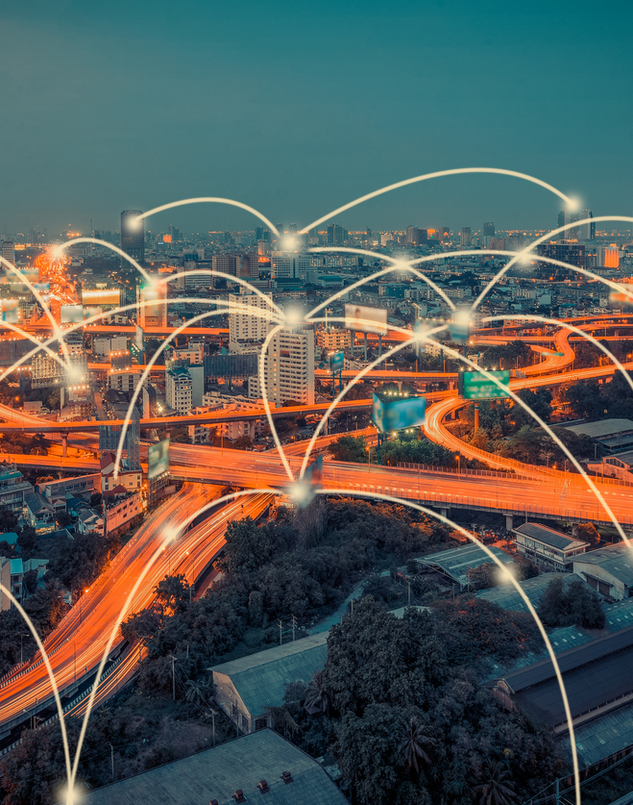
Internet of Things
A technology-enabled network of all networks
Swamini Shirsat (2103138)
Pranathi Ponnekanti (2103125)
Arya Gawde (2103115)
Ananya Alekar (2103108)

Slide 2
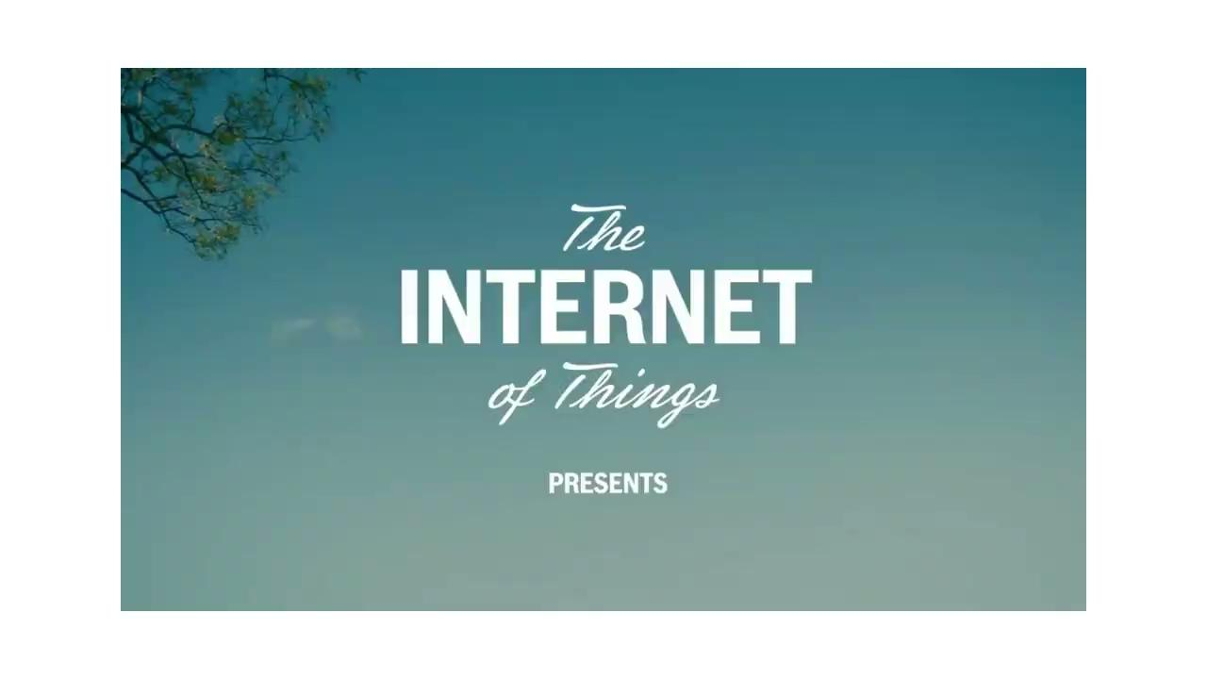

Slide 3
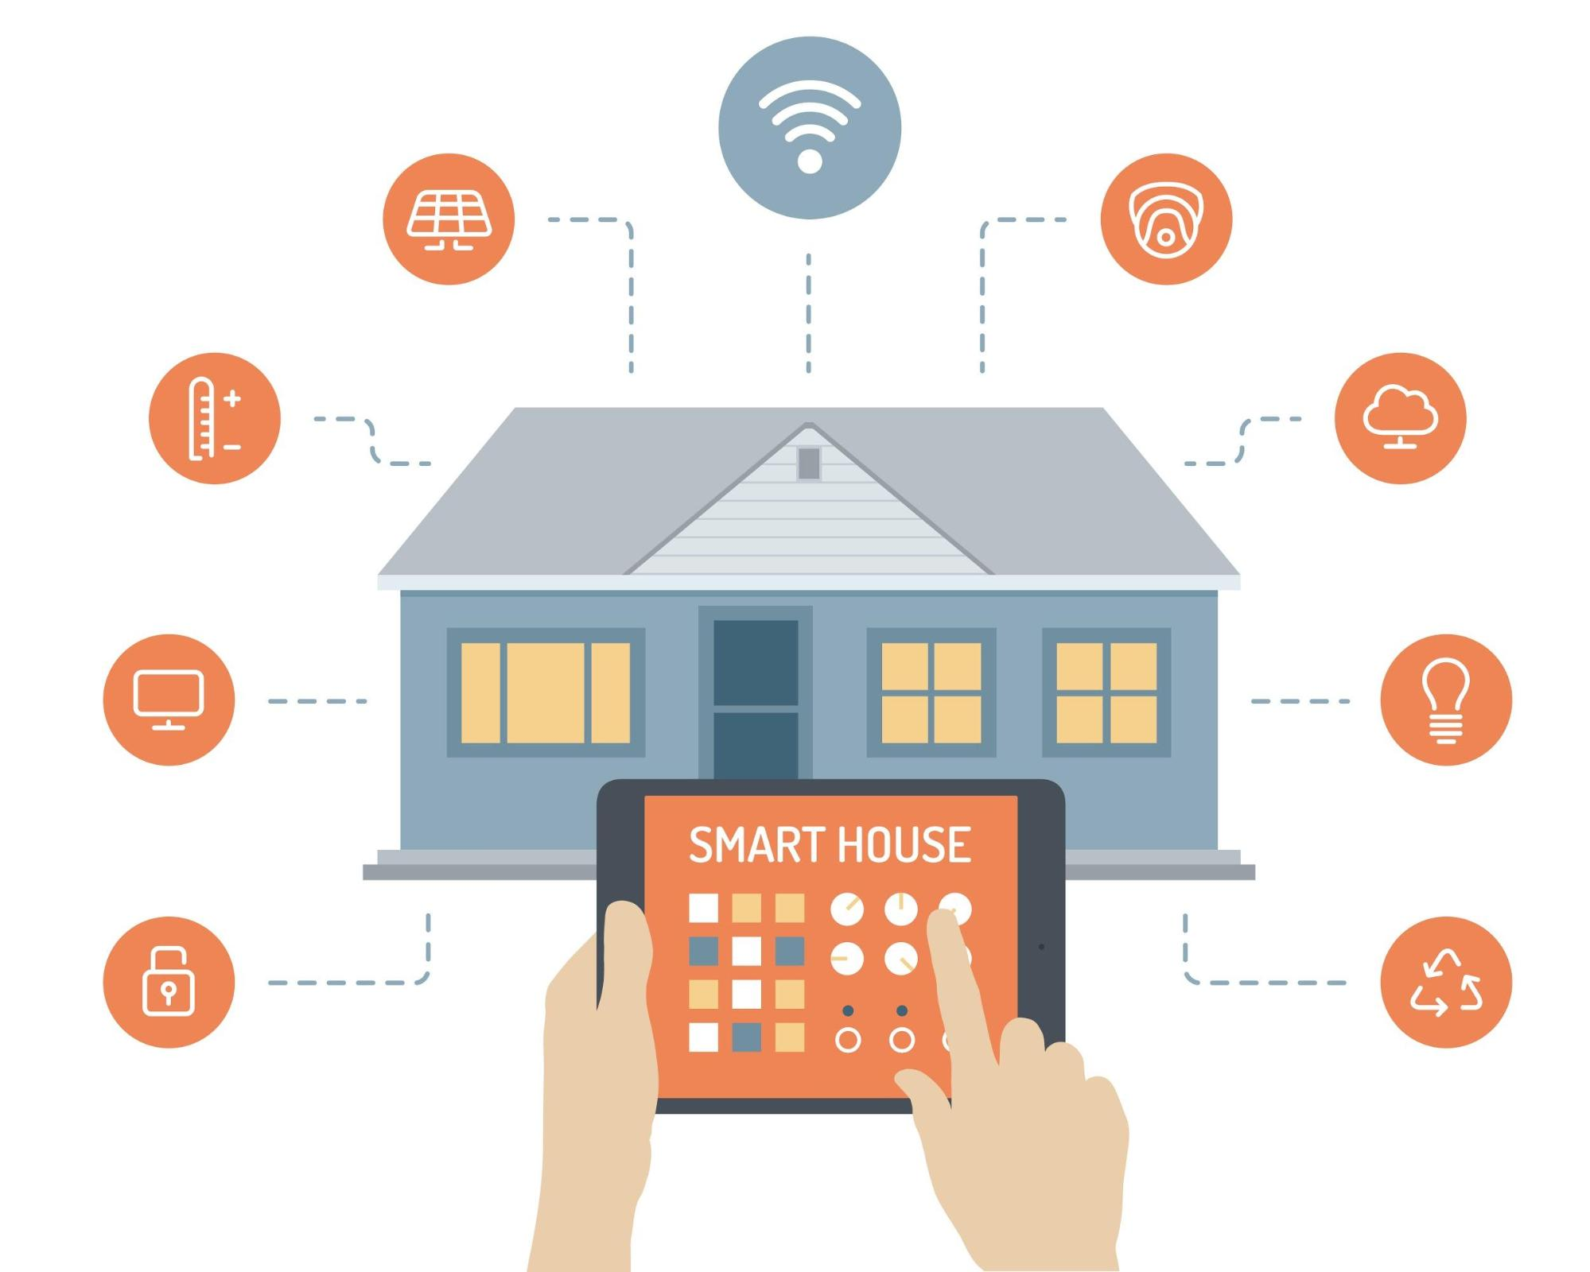
Home automation Applications and sensors
Lighting control - Lux sensors
Protocols and Gateways
Bluetooth low energy or Bluetooth Smart
Wireless protocol with mesh capabilities,
data encryption algorithms
Lawn/Gardening management - water level sensor
Z-wave
Specializes in home automation with an emphasis on security
Natural Language-based voice assistants - Voice/Sound sensors
Zigbee
low power radio frequency, mesh networked
Smart Switches and Smart Locks

Slide 4
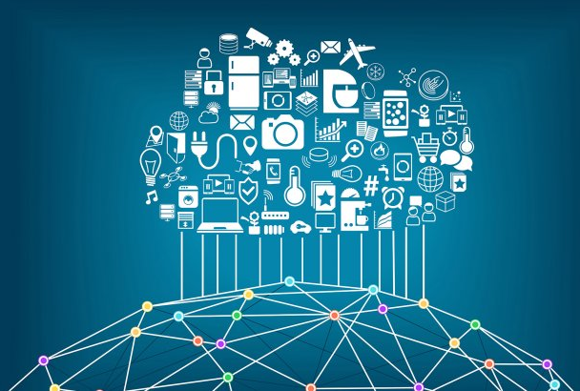
What is IoT?
A network connecting the physical world and digital world
These physical objects have sensors, network connectivity and software that connect them to different networks
Can now send, receive and exchange data with other devices and systems over the Internet.
Notes:
Mentioning IoT definition, history of iot and why is iot required in a sentence. Also how the cloud is related to IoT (because of the picture).

Slide 5
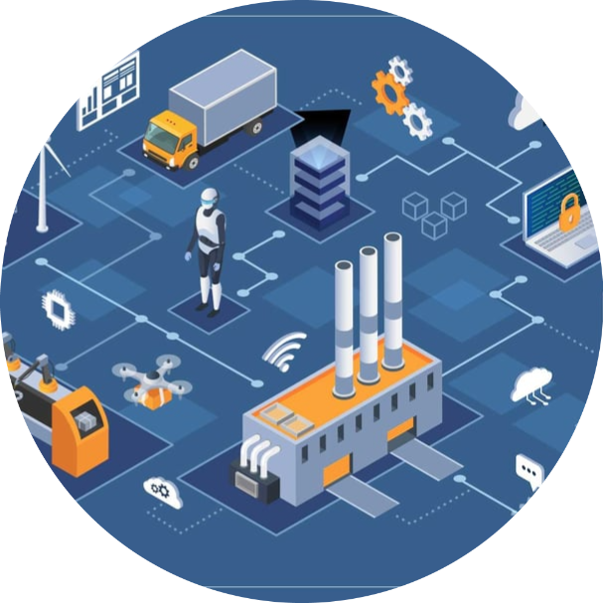
Characteristics of IoT
Connectivity
Intelligence
Low cost & power
Establishes connection
between the IoT devices.
Each IoT device has
it’s own identity.
Eg: MAC address in
CS212
Making available for more manufacturers.

Slide 6
Characteristics of IoT
Dynamic
Scalability
Network & Security
They should adapt to any kind of environment
( Self Adapting/ Self Configuration)
Eg: Sensors in A.C adjust itself
IoT has well organized
schemes to handle such enormous data holds.
Proper functioning & communication of devices using cloud service and gateway.
Safety and Privacy

Slide 7
Characteristics of IoT
Cloud computing-ML
Self Upgrading-AI
Interoperability
Consumers and manufacturers access the resources which give instant results without actually managing it.
Self upgrading technologies without any human help.
Advancement of NLP
Eg: Alexa, Siri
Architecture- supports a variety of devices & protocols.Interoperability enables different devices to work together seamlessly. Also known as “Heterogeneity”

Slide 8
Cloud
Devices
IoT
Analytics
User Interface

Slide 9
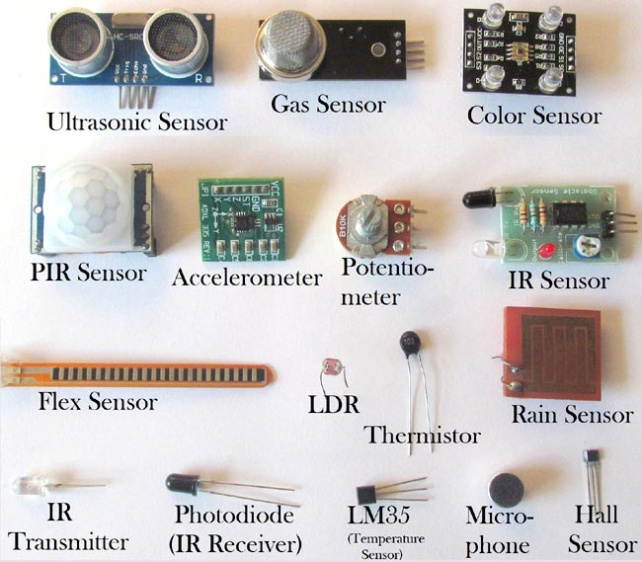
Devices
Sensors are connected to things
/ devices which collects data from
the device and send it into the
next layer called as ‘Gateway’
Some examples of sensors
1. Temperature , humidity and
pressure sensors
2. Proximity, Image and
Motion sensors

Slide 10
Cloud - Connectivity
Data collected from different devices gets stored in the cloud.
Cloud is responsible for handling data at high speeds even for a large number of devices, managing data and analyzing it continuously (24/7) over the internet.
Cloud architecture must be well defined.
Cloud Computing
Internet of Things
Proper functioning of IoT
CATALYST

Slide 11
IBM divides Cloud computing into 6 different categories
Platform as a service ( PaaS)
Software as a service ( SaaS)
Infrastructure as a service ( IaaS)
Cloud
Public Cloud
Private Cloud
Hybrid Cloud

Slide 12
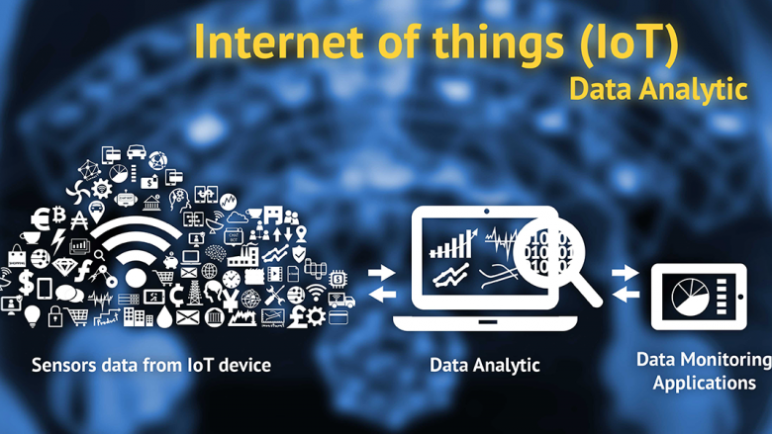
Data Processing & Analytics
The data is sent through the gateway
to the cloud and it gets processed here.
Then the analog information is converted
to usable data using various algorithms.
Coming to analytics, analysis of the raw
data for further processing is a
prerequisite for the monitoring and
enhancement of Internet of Things.

Slide 13
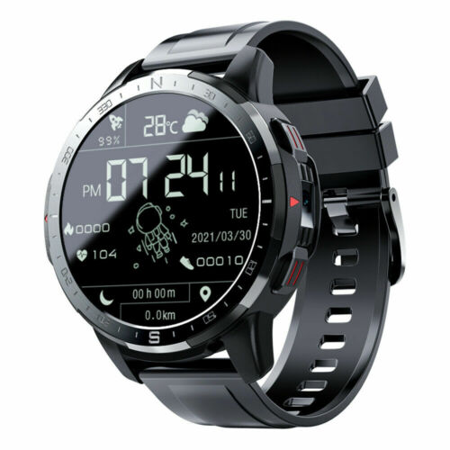
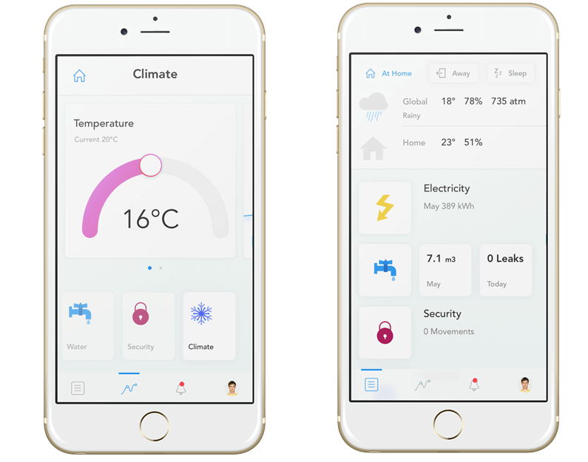
User Interface
Also referred to as UI
The data after being processed in the analytics section needs an interface where it can be displayed.
It allows users to edit and manipulate the data.

Slide 14
Here’s How IoT Data Collection Works
IoT Data Collection Technologies and Processes
01
Device Layer
IoT data collection involves the use of sensors to track the IoT network by collecting and transmitting real-time data that is stored and retrieved at any moment in time.
02
Communication Layer
03
IT Edge Layer
Several layers interplay to make the IoT data collection process work!
04
Event Processing Layereration
05
Client Communication Layer

Slide 15
DEVICE LAYER
Devices that communicate with each other form the primary layer
Controls things on edge
Eg: Refrigerator monitoring systems enable temperature sensors that take temperature readings.
Includes sensors that track environmental data, bluetooth devices, low-power radio-based devices, actuators.
Identities of devices categorized as
UUID (build in chip)
Radio IoT data collection systems - WiFi, bluetooth, etc.
COMMUNICATION LAYER
Network layer that transports data from the Device Layer to the Internet, via protocols (Gateway).
LoRaWAN sensors communicate with a gateway for what is considered edge processing. Then the gateway sends the data to the cloud via cellular connectivity.
Includes security functionality - authentication, encryption and malware protection may be done here.

Slide 16
3. CLOUD INGEST, DATA STORAGE, PROCESSING LAYER
At the data processing level, data such as images and readings from various sensors is received from the edge devices and gateways.
Cloud platform providers like AWS, Azure enable the ingestion and routing of the data flow to the cloud providing additional processing to store data and increase device deployments.
Eg: DATA PROCESSING AT REFRIGERATOR MONITORING SYSTEM
If samples’ temp out of configurable limit, send samples to the cloud via gateway
Temperature Sensors
Gateway
Cloud
Additional filtering to eliminate false alarms before altering end users of the problem
Gateway
Sensors are sampled every 5 mins and sample data is sent to the cloud
Samples received at the cloud

Slide 17
4. APPLICATION LAYER
The cloud generates reports and analysis for end users to applications and record keeping, via both web interfaces and email delivery.
Once the data is processed in the cloud, it’s used for applications like smart farming, healthcare, manufacturing, smart cities, fleet management, and others to monitor system performance, identify problems, and more.
5. CLIENT COMMUNICATION LAYER
This layer transfers data from the device to the user.
This data is transferred to user application via machine to machine APIs.

Slide 18
Types of IoT Data Protocols
These protocols are applicable in the Application Layer of the OSI model. They provide communication with hardware without the need for an Internet connection.
SNMP
CoAP
MQTT
LwM2M

Slide 19
Simple Network Management Protocol (SNMP)
Used to monitor and manage devices on a LAN or a WAN
Based on the client-server architecture model
Has three components: manager, agent and management information base

Slide 20
Constrained Application Protocol (CoAP)
A lightweight M2M protocol used in networks having low bandwidth and connectivity
More specifically, constrained networks
Follows client-server architecture and based on request-response communication model
Preferred due to its low overhead and better data encryption over HTTP

Slide 21
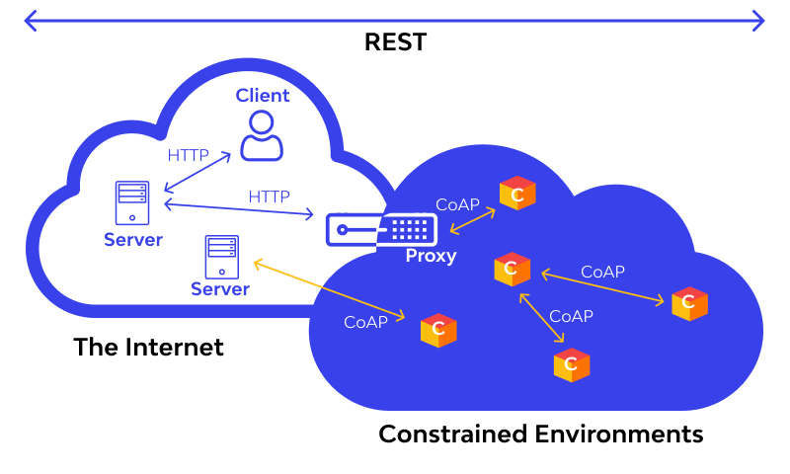

Slide 22
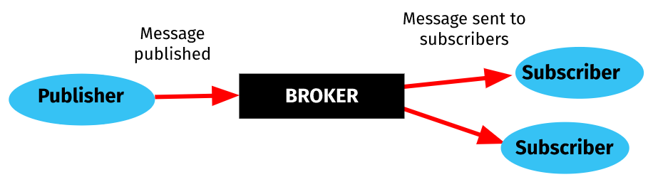
Message Queueing Telemetry Transport
Works on the Publish-Subscribe model
Similar to TV broadcasting or radio
Possible to connect to 0, 1 or multiple clients
No direct connection between the publisher and subscriber

Slide 23
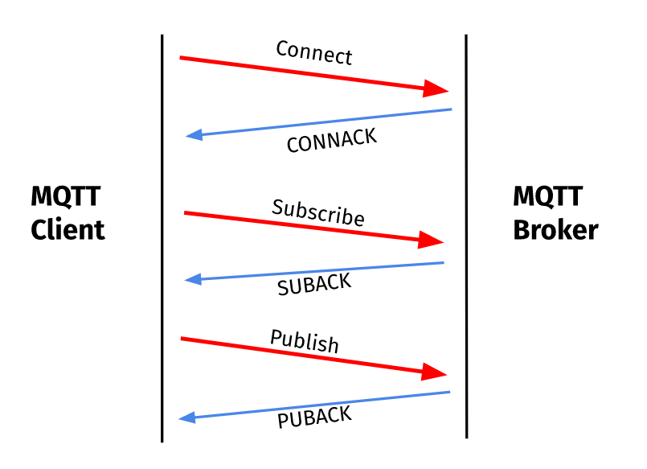
How does an MQTT client connect to a broker?
MQTT uses TCP\IP to connect the client to the broker.
Clients connect to the broker by sending a connection request.
No client can publish or subscribe without a connection.

Slide 24
Lightweight Machine-2-Machine
Communication protocols between an LwM2M Server and LwM2M Client
Designed to reduce power and data consumption
Caters to devices with low power needs and limited processing and storage capabilities
Number of IoT devices is increasing and will reach 75 billion by the end of 2025, hence such a quicker and easier, less power consuming communication is needed.

Slide 25
CONS
PROS
Saves time
Reduces human effort
Increasing connectivity
Has multiple applications like health and safety
Reduces cost of many industrial processes
Uninterrupted flow of information
Lack of privacy
Heavily dependent on the internet
Prone to faults due to its complexity
Increasing unemployment
Deployment is expensive and tedious
Increasing dependency of humans makes them lazy

Slide 26

https://demo.thingsboard.io/
DEMO

Slide 27
References
https://www.hivemq.com/blog/mqtt-essentials-part-5-mqtt-topics-best-practices/
https://www.catchpoint.com/network-admin-guide/mqtt-broker
https://www.emqx.com/en/blog/how-to-use-mqtt-in-python - Python tutorial to simulate MQTT
http://www.steves-internet-guide.com/mqtt-works/
https://www.avsystem.com/blog/lightweight-m2m-lwm2m-overview/
https://data-flair.training/blogs/how-iot-works/
https://www.youtube.com/watch?v=v2kV6pgJxuo - YouTube video
https://www.geeksforgeeks.org/characteristics-of-internet-of-things/
https://www.oracle.com/in/internet-of-things/what-is-iot/
www.tutorialspoint.com/what-are-the-characteristics-of-internet-of-things-iot
https://thingsboard.io/ - Thingsboard demonstration
https://www.scaler.com/topics/components-of-iot/
https://www.leverege.com/iot-ebook/how-iot-systems-work#:~:text=However%2C%20all%20complete%20IoT%20systems,processing%2C%20and%20a%20user%20interface.
https://www.zipitwireless.com/blog/what-are-iot-sensors-types-uses-and-example
https://www.geeksforgeeks.org/iot-and-cloud-computing/
https://www.wallarm.com/what/coap-protocol-definition
https://en.wikipedia.org/wiki/Internet_of_things
https://www.nabto.com/guide-iot-protocols-standards/
https://www.avsystem.com/blog/iot-protocols-and-standards/
https://www.nabto.com/iot-protocols-comparison/

Slide 28
Thank You

